Slide 1


Applied Data Science
Dr. Payal Varangaonkar
Assistant Professor
Department of Electronics and Computer Engineering
K. J. Somaiya College of Engineering
Somaiya Vidyavihar University

Slide 2
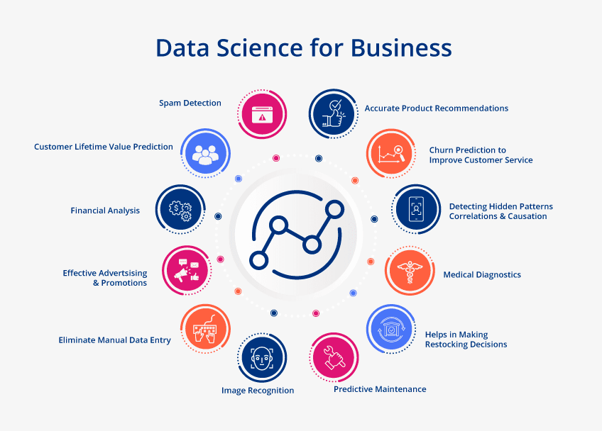
Impact of applying data science in business scenario

Slide 3
Impact of applying data science in business scenario
Data science for business decision-making: Companies can evaluate the efficiency of their operations by basing their reporting on accurate and up-to-date data. Business intelligence provides essential data on the company's recent and historical productivity as well as future projections, anticipated demands, shopping habits, etc., to assist businesses in making informed decisions on important planning. Business analytics teams make sure the organization gets real-time, enhanced reports so it can use the data available to operate the business more effectively.

Slide 4
Impact of applying data science in business scenario
Making quality products: Businesses require data to maximize product development following the needs and expectations of the client. With the help of data analysis, companies develop the best products.

Slide 5
Impact of applying data science in business scenario
Effective business management: Small and large businesses can efficiently manage their operations and develop themselves through data science. Using data science, companies can predict the success of their strategies.

Slide 6
Impact of applying data science in business scenario
Forecasting using predictive analysis: Forecasting is a significant application of data science in business. Companies use analytical tools and technologies to develop their data mining proficiency. Businesses can use predictive analysis to extract insights that could affect their operations and then take the appropriate action.

Slide 7
Impact of applying data science in business scenario
Leveraging data for business decisions: Without surveys, businesses would make poor decisions and incur losses since projection is necessary for businesses to understand the future.

Slide 8
Impact of applying data science in business scenario
Evaluating business resolutions: Companies can make accurate business decisions quickly by projecting future events and trends. How the resolutions that are implemented affect their growth and performance the business should be fully aware of that.

Slide 9
Impact of applying data science in business scenario
Fraud and risk management: Due to their expertise, data scientists can recognize data that stands out. Then they can create a network, a path, and data-driven ways that foresee fraud.

Slide 10
Impact of applying data science in business scenario
Recruiting automation: In an era of intense competition for high performers, these organizations understand that the usual process for hire simply doesn't work as effectively as it once did. In comparison to the objectives they are attempting to attain, these businesses seek to produce greater results in less time and frequently with fewer resources.

Slide 11
Need of Estimation and Validation in Data Science
There is always a need to validate the stability of your machine learning model. I mean you just can’t fit the model to your training data and hope it would accurately work for the real data it has never seen before. You need some kind of assurance that your model has got most of the patterns from the data correct, and its not picking up too much on the noise, or in other words its low on bias and variance.

Slide 12
Need of Estimation and Validation in Data Science
Validation
This process of deciding whether the numerical results quantifying hypothesized relationships between variables, are acceptable as descriptions of the data, is known as validation.
Generally, an error estimation for the model is made after training, better known as evaluation of residuals. In this process, a numerical estimate of the difference in predicted and original responses is done, also called the training error. However, this only gives us an idea about how well our model does on data used to train it. Now its possible that the model is underfitting or overfitting the data.
So, the problem with this evaluation technique is that it does not give an indication of how well the learner will generalize to an independent/ unseen data set. Getting this idea about our model is known as Cross Validation.

Slide 13
Need of Estimation and Validation in Data Science
Holdout Method
Now a basic remedy for this involves removing a part of the training data and using it to get predictions from the model trained on rest of the data. The error estimation then tells how our model is doing on unseen data or the validation set. This is a simple kind of cross validation technique, also known as the holdout method. Although this method doesn’t take any overhead to compute and is better than traditional validation, it still suffers from issues of high variance. This is because it is not certain which data points will end up in the validation set and the result might be entirely different for different sets.

Slide 14
Need of Estimation and Validation in Data Science
K-Fold Cross Validation
As there is never enough data to train your model, removing a part of it for validation poses a problem of underfitting. By reducing the training data, we risk losing important patterns/ trends in data set, which in turn increases error induced by bias. So, what we require is a method that provides ample data for training the model and also leaves ample data for validation. K Fold cross validation does exactly that.
In K Fold cross validation, the data is divided into k subsets. Now the holdout method is repeated k times, such that each time, one of the k subsets is used as the test set/ validation set and the other k-1 subsets are put together to form a training set. The error estimation is averaged over all k trials to get total effectiveness of our model. As can be seen, every data point gets to be in a validation set exactly once, and gets to be in a training set k-1 times. This significantly reduces bias as we are using most of the data for fitting, and also significantly reduces variance as most of the data is also being used in validation set. Interchanging the training and test sets also adds to the effectiveness of this method. As a general rule and empirical evidence, K = 5 or 10 is generally preferred, but nothing’s fixed and it can take any value.

Slide 15
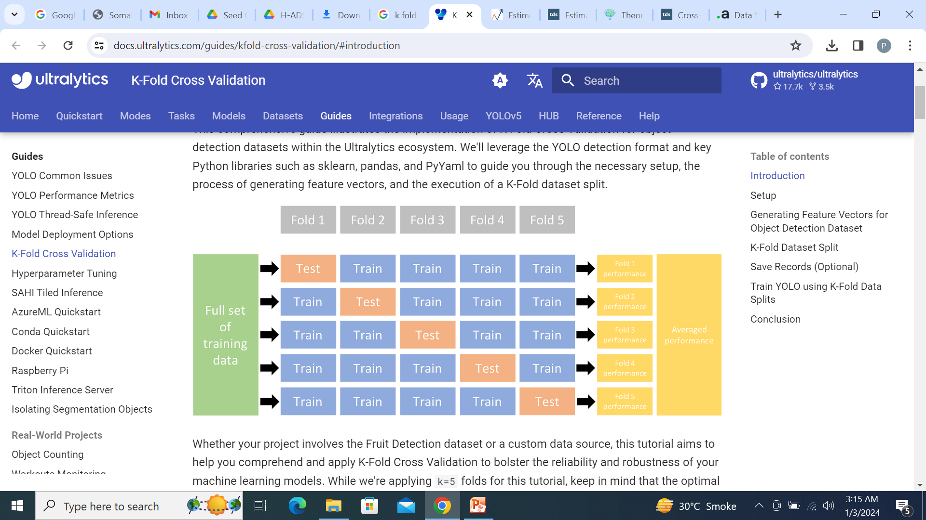
K- Fold Cross Validation

Slide 16
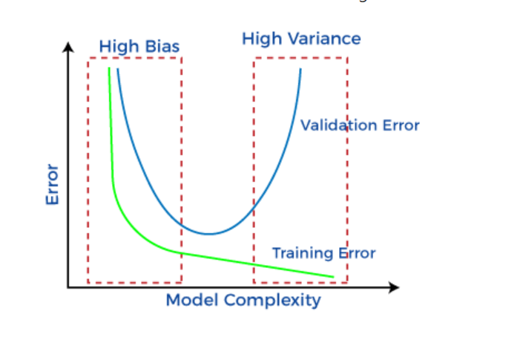
Errors in Machine Learning
While making predictions, a difference occurs between prediction values made by the model and actual values/expected values, and this difference is known as bias errors or Errors due to bias.
Low Bias: A low bias model will make fewer assumptions about the form of the target function.
High Bias: A model with a high bias makes more assumptions, and the model becomes unable to capture the important features of our dataset. A high bias model also cannot perform well on new data.
Low variance means there is a small variation in the prediction of the target function with changes in the training data set. At the same time, High variance shows a large variation in the prediction of the target function with changes in the training dataset.
A model that exhibits small variance and high bias will underfit the target, while a model with high variance and little bias will overfit the target. A model with high variance may represent the data set accurately but could lead to overfitting to noisy or otherwise unrepresentative training data.

Slide 17
Question
?

